Slide 1
Do not delete this slide.
This slide is designed so that you can copy the prompt box you need and insert it into your slides.
This slide is hidden and will not be included when presenting your lesson.
TRACK WITH ME
VOCABULARY
1 -
HINT
Students, remember….
CHECK FOR UNDERSTANDING
READ WITH ME
TEACHER CUE
MAKE THE CONNECTION
Students, you already know….
EXTENSION
GESTURE WITH ME

Slide 2
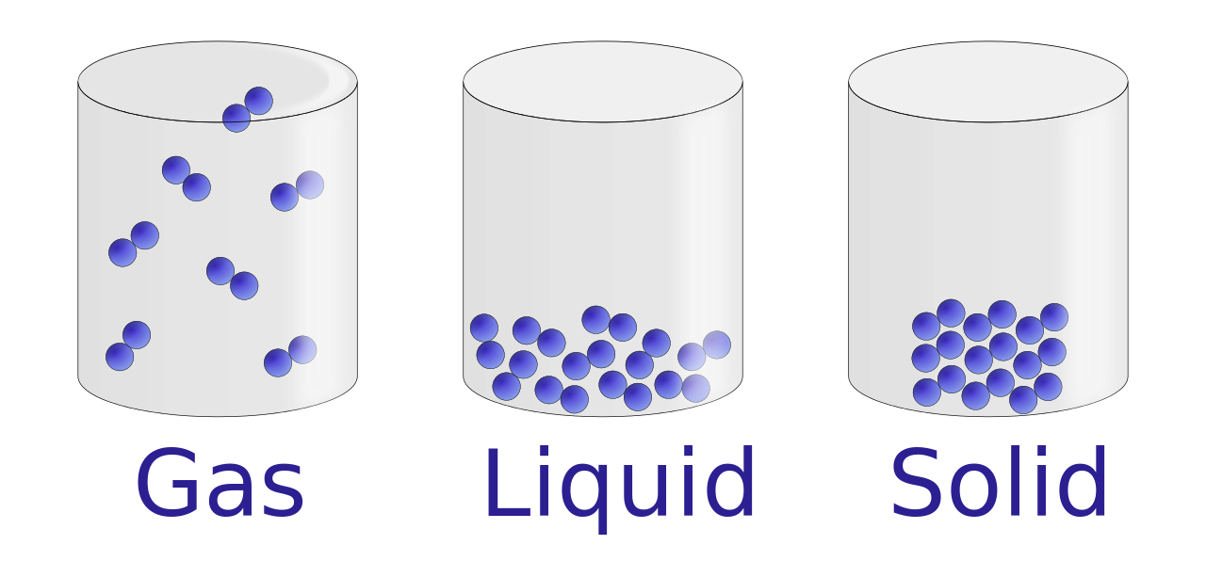


Recall the arrangement of particles in solid, liquid and gas. Identify which state of matter is which.
Sound energy is the results due to the v__________ of the particles.
Sound energy can travel in 3 states of matter. They are
S_______
L_______
G______
Which of the following two has a higher frequency?
Based on the particle model, predict which matter will have an easier time transmitting energy from one particle to another particle.

Slide 3
Repeat the opposite word/phrase.
SOUNDWAVES
m__________ wave that results from the b____ and f____ v________ of the particles
Example: In space, sound cannot travel because there is no particle to vibrate.

Slide 4
Repeat the opposite word/phrase.
SOUNDWAVES
mechanical wave that results from the back and forth vibration of the particles
Example: In space, sound cannot travel because there is no particle to vibrate.

Slide 5
Repeat the opposite word/phrase.
FREQUENCY
the ________ of ________ cycles that occur in _____ second
Example: A female speaking voice is around 165 Hertz to 255 Hertz while a male speech range is about 80 Hertz to 155 Hertz.

Slide 6
Repeat the opposite word/phrase.
FREQUENCY
the number of soundwaves cycles that occur in one second
Example: A female speaking voice is around 165 Hertz to 255 Hertz while a male speech range is about 80 Hertz to 155 Hertz.

Slide 7
Repeat the opposite word/phrase.
HERTZ
Unit of _________ measurement
Example: The middle C in piano key is around 261 Hertz. An octave lower than middle C is around 130 Hertz.

Slide 8
Repeat the opposite word/phrase.
HERTZ
Unit of frequency measurement
Example: The higher the Hertz, the more soundwaves cycle occur in one second

Slide 9
Repeat the opposite word/phrase.
MEDIUM
The ______ through which a wave travels
Example: Sound travels in solid, liquid and gas state of matter.

Slide 10
Repeat the opposite word/phrase.
MEDIUM
The matter through which a wave travels
Example: Sound travels in solid, liquid and gas state of matter.

Slide 11
Repeat the opposite word/phrase.
VOLUME
The a________ or l______ of a sound

Slide 12
Repeat the opposite word/phrase.
VOLUME
The amplitude or loudness of a sound

Slide 13
Repeat the opposite word/phrase.
_________
a unit used to measure how loud a sound is
Example: Sound below 80 dB is generally safe for human ears; anything above 90dB, when exposed to a long period of time will damage the eardrums.

Slide 14
Repeat the opposite word/phrase.
DECIBELS
a unit used to measure how loud a sound is
Example: Sound below 80 dB is generally safe for human ears; anything above 90dB, when exposed to a long period of time will damage the eardrums.

Slide 15
Repeat the opposite word/phrase.
PITCH
How high or how low a sound is
Example: Female generally sing in a higher pitch than male.

Slide 16
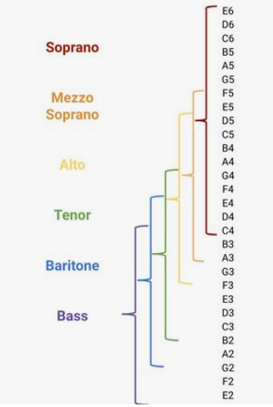
Challenge of the day:
How high of a pitch can you sing?
(Hint: normal vocal range from E2 to E6)

Slide 17
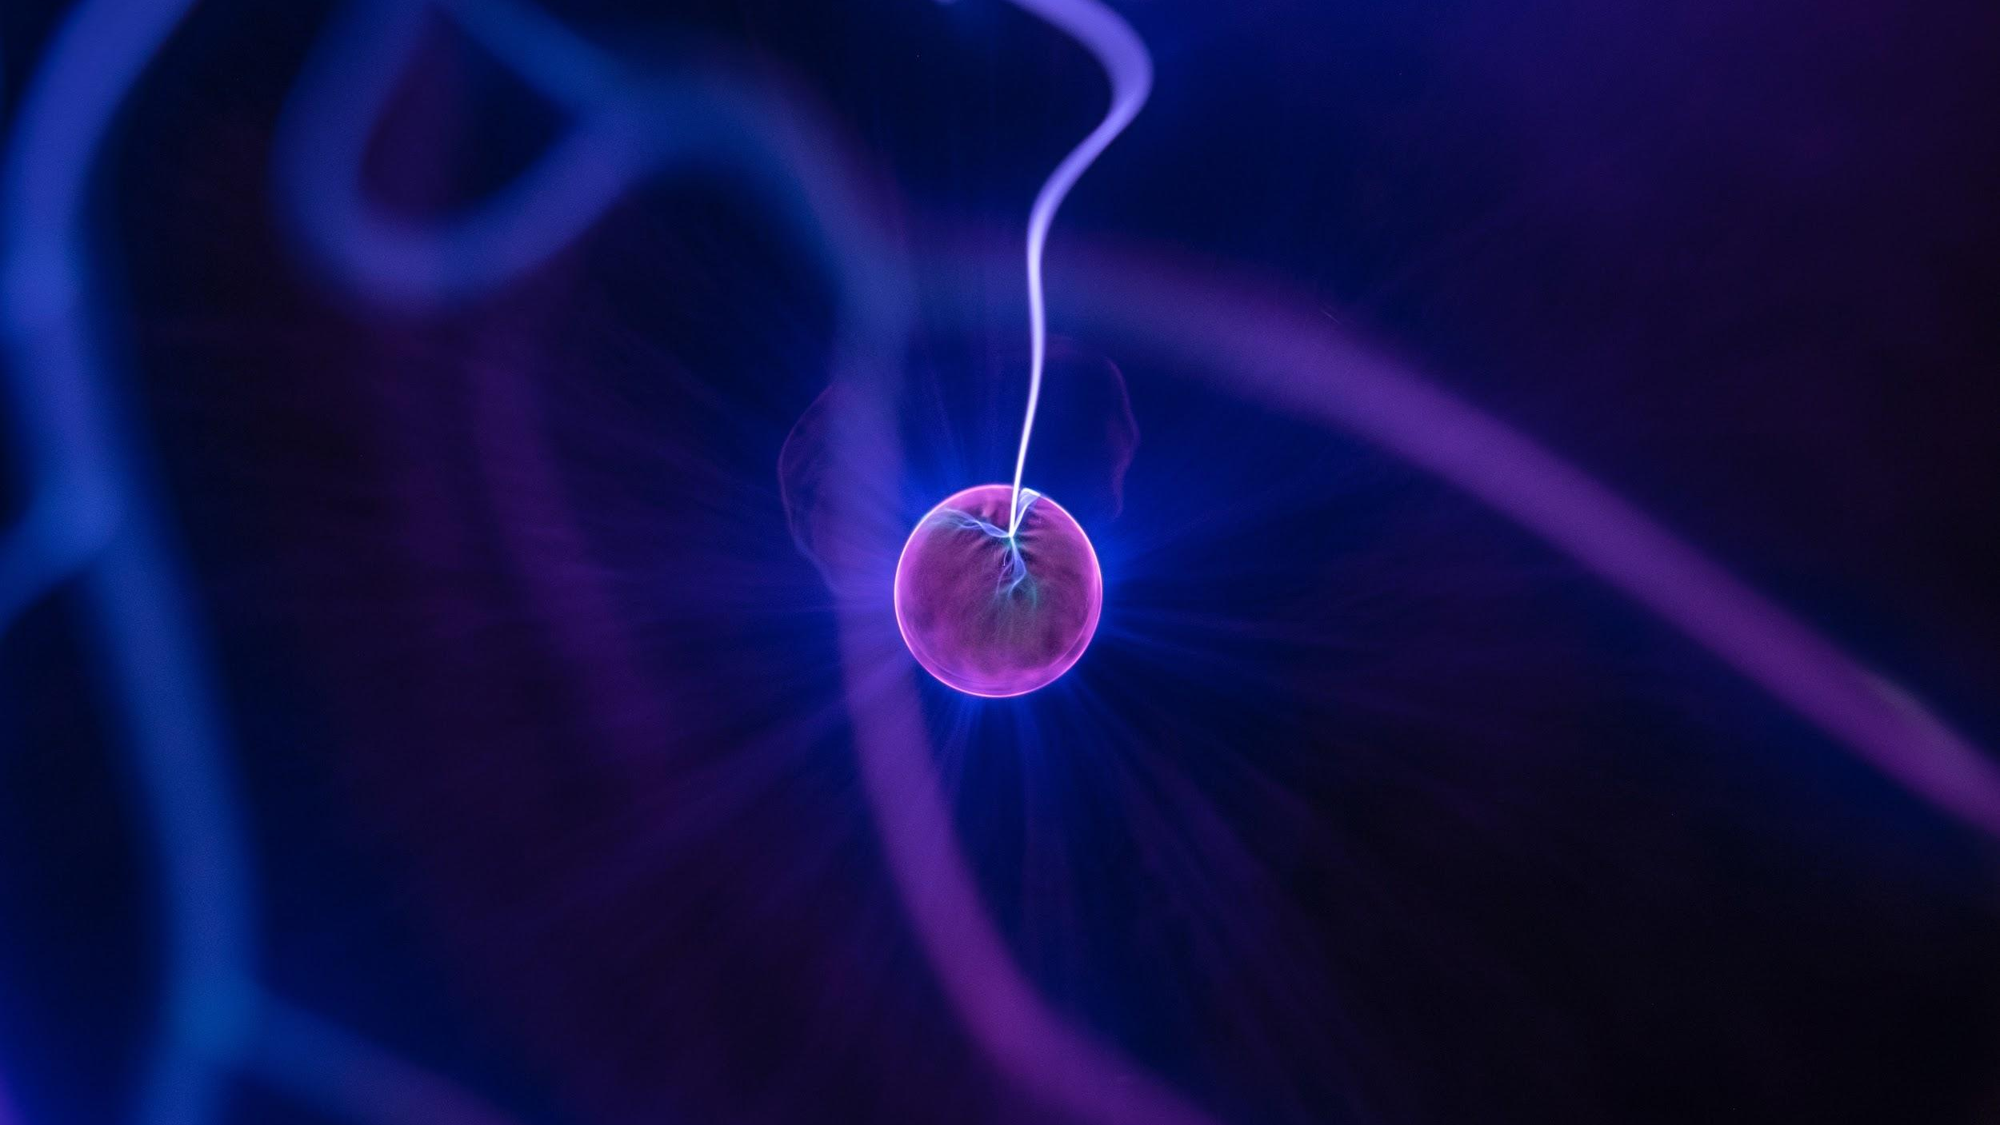

Light Energy
Notes:
Insert cover image and use transparency settings to fade image.

Slide 18
TRACK WITH ME
Understand light energy
READ WITH ME
I can define and describe light energy
I can identify types of lights using the electromagnetic spectrum
I can describe and explain how lights behave
DECLARE THE OBJECTIVE
Read the learning objective to your partner.

Slide 19
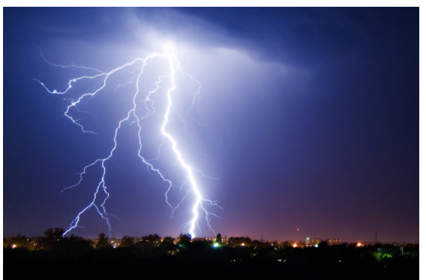
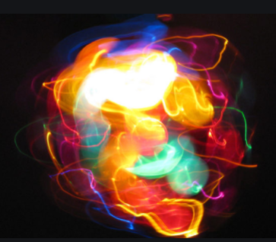
Radiant/ Light Energy
Light is defined as a form of electromagnetic radiation emitted by hot objects like lasers, bulbs, and the sun.
Light contains photons which are minute packets of energy.
It can travel through the space, unlike sound.
However, not all lights are visible.
What are the colours we see in the rainbow?
Notes:
https://www.youtube.com/watch?v=d7yTlp4gBTI

Slide 20
Radiant/ Light Energy
Visible light that we see only form part of the electromagnetic spectrum. There are other types of lights that are not visible to human eyes.
And they are harmful usually!
T-P-S: Come up with a few invisible lights that you heard of
Notes:
https://www.youtube.com/watch?v=d7yTlp4gBTI

Slide 21
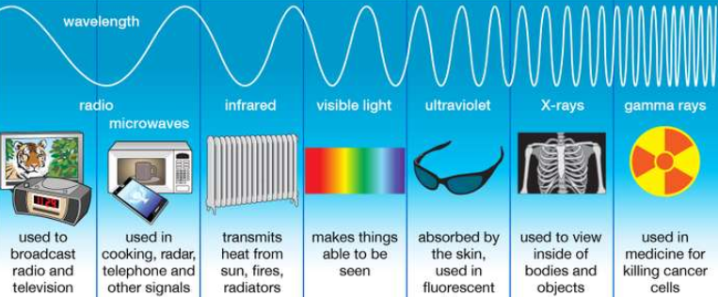
Radiant/ Light Energy
Visible light that we see only form part of the electromagnetic spectrum. There are other types of lights that are not visible.
Notes:
https://www.youtube.com/watch?v=d7yTlp4gBTI

Slide 22
Light Video
Notes:
https://www.youtube.com/watch?v=d7yTlp4gBTI

Slide 23

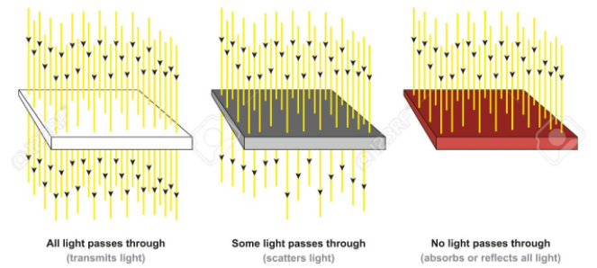
Transparent vs Translucent vs Opaque
Notes:
https://www.youtube.com/watch?v=d7yTlp4gBTI

Slide 24
Light Study Jam
Watch the video then answer questions using Plickers:
http://studyjams.scholastic.com/studyjams/jams/science/energy-light-sound/light.htm
Notes:
http://studyjams.scholastic.com/studyjams/jams/science/energy-light-sound/light.htm

Slide 25
Exit Ticket: 3R2H1Q
3 Recalls:
Light travels in waves form and in straight paths
Transparent objects allow all light beams to pass through it
Hmm, what else do I recall? List 3 facts about light that you learned
2 Highlights:
I can’t believe there are invisible lights
What else???
3 Recalls/ Remember
2 Highlights
1 Question
1 Question:
How will light behave when it is underwater?
Notes:
http://studyjams.scholastic.com/studyjams/jams/science/energy-light-sound/light.htm

Slide 26
Exit Ticket: 3R2H1Q
3 Recalls:
Light travels in waves form and in straight paths
There are visible and invisible lights
Electromagnetic spectrum
Leaf is green in color because it reflects green light
White color is actually the result of all the visible lights blend together
2 Highlights:
I like the dinosaur analogy
I can’t believe there are invisible lights
Black color absorbs all the lights!!!
3 Recalls/ Remember
2 Highlights
1 Question
1 Question:
How will light behave when it is underwater?
Notes:
http://studyjams.scholastic.com/studyjams/jams/science/energy-light-sound/light.htm

Slide 27
Reading Challenge (Popcorn)
As an object rubs against another, the objects gain heat. This is due to friction forces. For example, when you are cold in winter, you keep rubbing your hands to generate heat.
Any contact between 2 objects results in heat transfer due to friction.
For example, your car’s tyres become increasingly hot after a long drive.
Heat is often unwanted, so is lost as “waste energy”. For example, the heat on your car tyre is unwanted, because it can damage the rubber.
and sound are common examples of wasted energy such as the light produced from a heater or the sound produced by an engine.

Slide 28
Making the shadow bigger Activity
Notes:
http://studyjams.scholastic.com/studyjams/jams/science/energy-light-sound/light.htm

Slide 29
Black vs white shirt under the sun
Notes:
http://studyjams.scholastic.com/studyjams/jams/science/energy-light-sound/light.htm

Slide 30
PRISM
Notes:
http://studyjams.scholastic.com/studyjams/jams/science/energy-light-sound/light.htm

